Slide 1

M & B Insurance Company
Predictive and Prescriptive Analysis using unsupervised machine learning

Slide 2
Data Wrangling
Cleaned data for modeling by handling missing values in CREDIT_LIMIT, MINIMUM_PAYMENT, removed outliers, encoded categorical variables, scaled numerical features, selected relevant features, and split data into training and testing sets. Addressed class imbalance if needed. Ensured data is ready for machine learning.

Slide 3
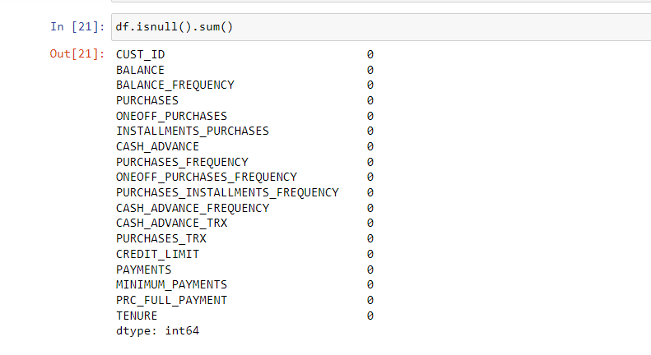
Data Validating

Slide 4
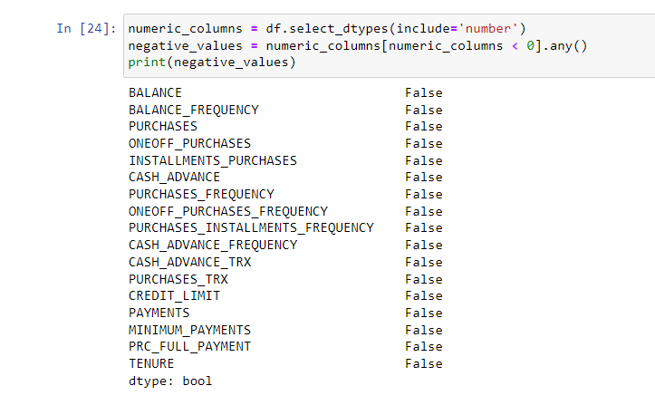
Data Validating

Slide 5
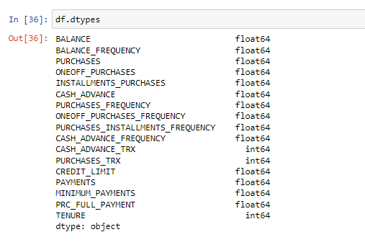
Data Validating

Slide 6
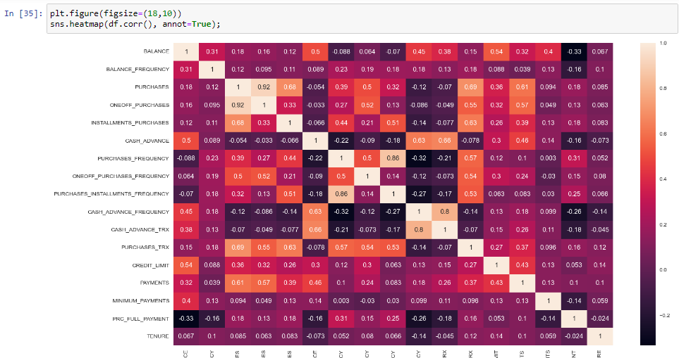
Correlation Map

Slide 7
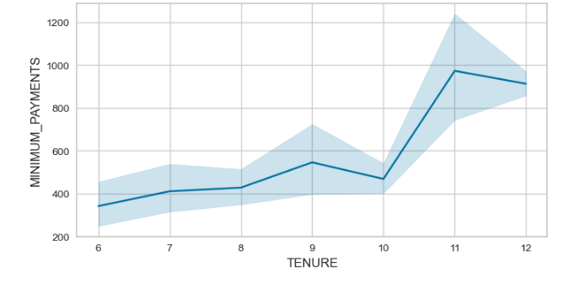
Bivariate Analysis on Minimum Payment & Tenure

Slide 8
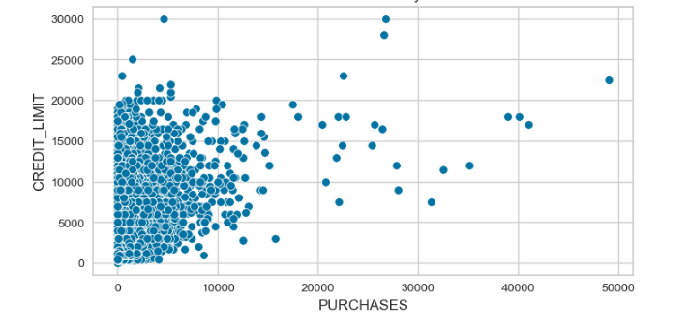
Bivariate Analysis on Credit Limit & Purchases

Slide 9
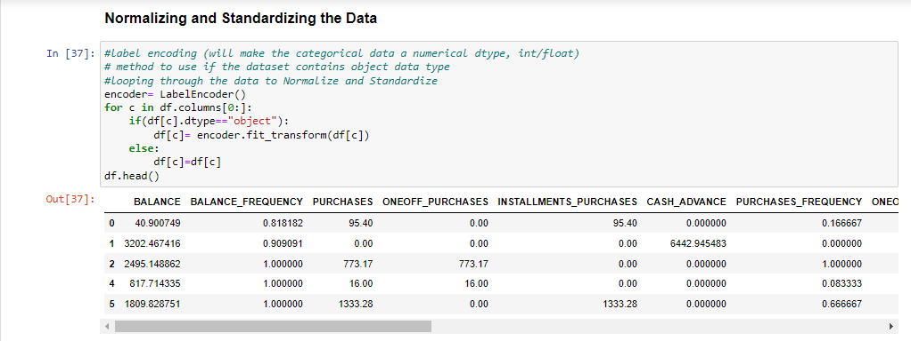
Data Preprocessing and Feature Engineering
Utilized the Label Encoder() to transform categorical variables to numerical variable to fit for modeling algorithms.

Slide 10
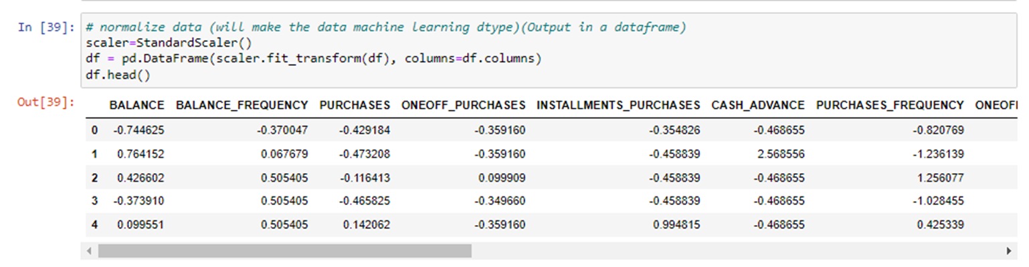
Data Preprocessing and Feature Engineering
Utilized the Standard Scaler() to rescale and transform your dataset values, ensuring they fall within the range of -1 to +1.

Slide 11
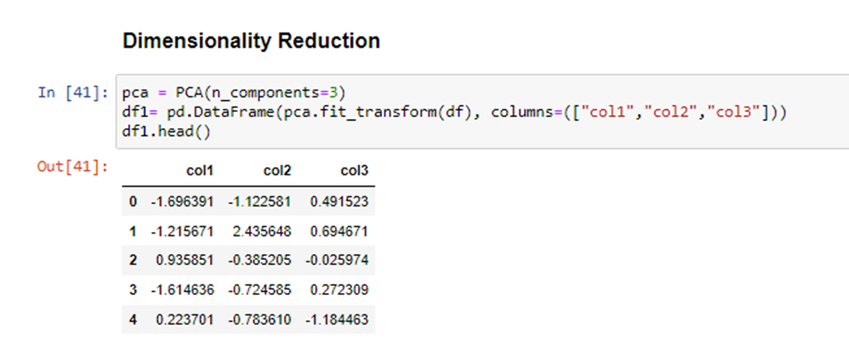
Data Preprocessing and Feature Engineering
Utilized the Principal Component Analysis PCA() to rescale and transform your dataset values, ensuring they fall within the range of -1 to +1.

Slide 12
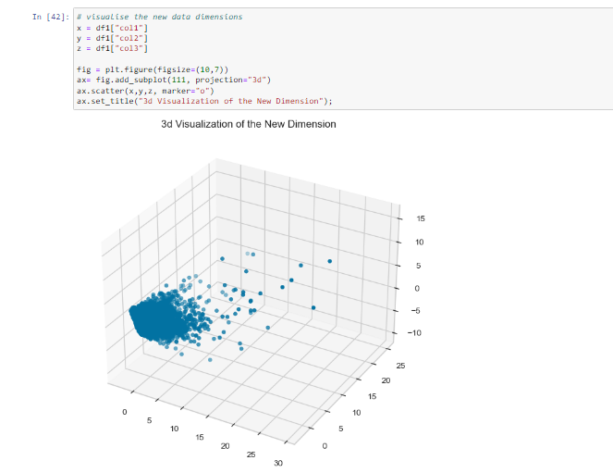
Visualizing the decomposed data on a 3D Visuals

Slide 13
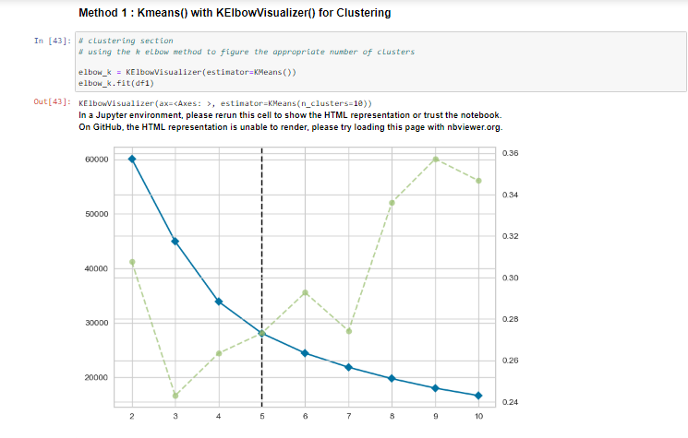
KElbow Visualizer() for Clustering

Slide 14
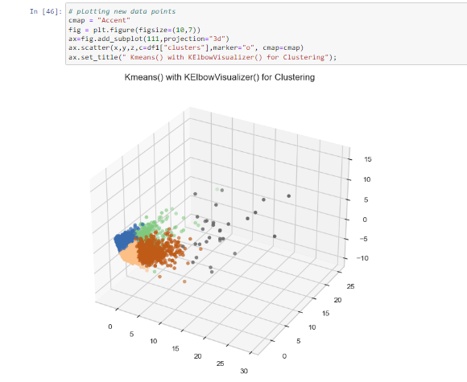
Kmeans() with KElbow Visualizer() for Clustering

Slide 15
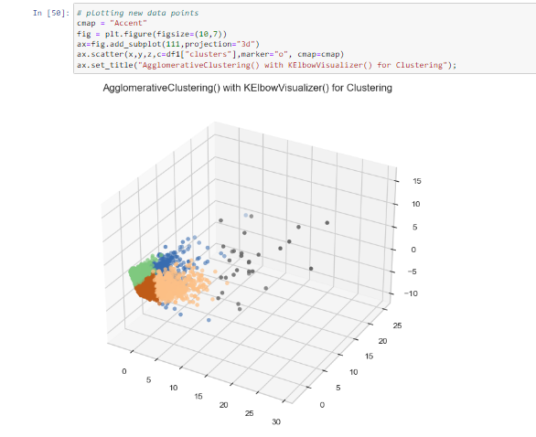
Distortion Score Elbow for Agglomerative Clustering()

Slide 16
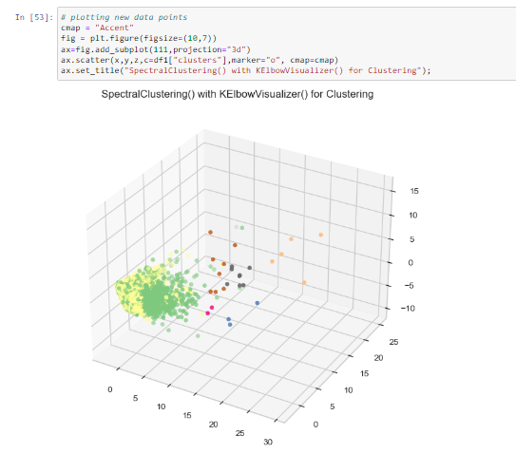
Distortion Score Elbow for Spectral Clustering()

Slide 17
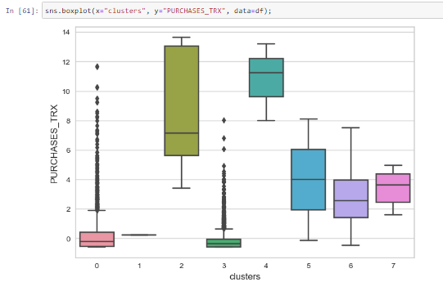
Clusters Views : Purchases Transactions
Captured the purchasing behaviour of customers after clustering into 7 places.

Slide 18




Conclusion
Considering the application of three distinct clustering approaches to categorize clients based on their purchase patterns and tenure, we can now evaluate and recommend the most suitable method.
After a thorough analysis, a particular clustering approach has demonstrated superior performance in achieving meaningful customer segmentation and personalizing coverage recommendations and pricing.
Therefore, I recommend adopting this specific clustering approach to enhance M&B Insurance's risk assessment, customer segmentation, and communication strategies. This proactive strategy is poised to not only elevate client satisfaction but also foster sustainable growth within the insurance industry.
Given the clustering approaches employed, which one would you advise as the most suitable choice?

